Slide 1
Texas Community Development Block Grant Program
PY 2023 Application Guide Updates

Slide 2
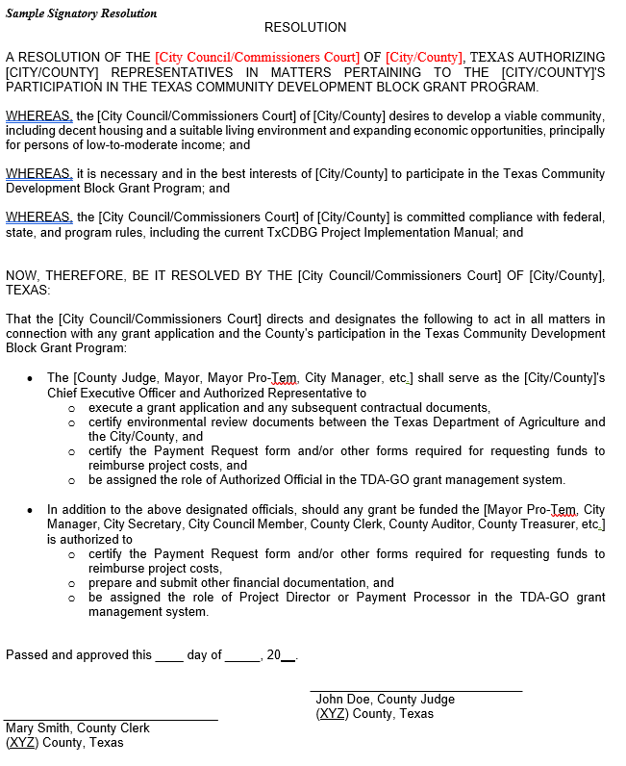
NEW: Signatory Resolution
Once the Signatory Resolution is adopted and submitted to TDA-GO, the community may continue to rely on the same resolution for subsequent TxCDBG applications.
The community may provide an updated resolution at any time as local needs change.
Only those named in the resolution will be permitted to take action in TDA-GO on behalf of the community.
Notes:
TxCDBG applications and grant agreements require a resolution from the local governing body (i.e., County Commissioners Court or City Council) authorizing specific individuals and/or positions to take action on behalf of the community. (To allow for local changes in personnel, TDA recommends identifying the signatories by position.)
This is a separate document, and in addition to, the resolution authorizing the submission of the application. Upload in Applicant’s Organization Details page. This will require local action to complete (cannot be completed by third-party admin). But bonus, only have to do once and update as appropriate.

Slide 3
Financial Capacity
Applicant must indicate willingness to adhere to financial management controls included in any resulting grant award; and
If recommended for funding, must complete a Financial Capacity Self-Assessment prior to release of grant funds.
If determined necessary, conditions may be included in the grant agreement to ensure appropriate financial capacity.

Slide 4
Build America, Buy America (BABA)
Grants funded under 2023 Application Guides will be required to comply with Build America Buy America (BABA) provisions.
HUD Guidance on BABA implementation not yet published
TDA to update Project Implementation Manual and other resources as guidance becomes available and prior to execution of a grant agreement for applicants submitted in PY 2023 and beyond.

Slide 5
Other Minor Corrections
Correction to application thresholds for FAST contracts
Correction to CD Match scoring matrix
Table of Contents corrected
Appendix I to be published this week!

Slide 6
Updates to Eligible Activities under CD
All eligible TxCDBG program activities, including planning activities.
Related Planning Activities: to be completed in conjunction with an eligible construction activity, limited to the type of construction activity proposed.
Comprehensive Planning Activities: Requesting funds for community-wide comprehensive plan, up to $75K
Check out Webinar recording on TxCDBG Training Page for more info

Slide 7
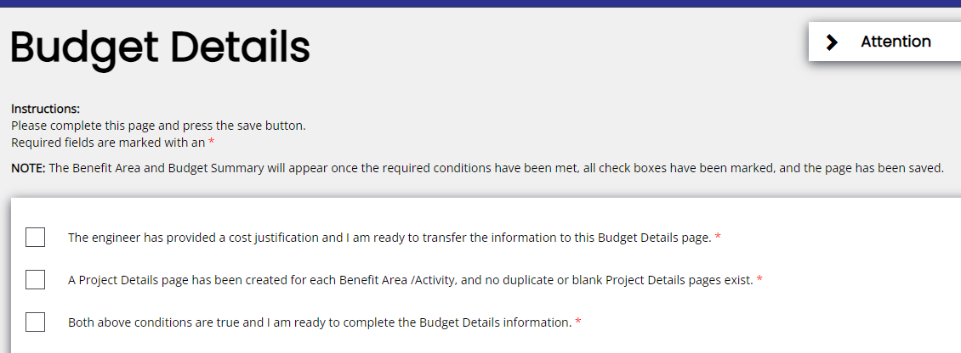
Application Form Updates

Slide 8
Application Form Updates

Slide 9
Common Questions
12- and 24-month thresholds
Using ARPA toward match contribution
Applications providing benefit to ETJ residents
Planning activities and scoring for CD
Before photos
Sneak peak of Financial Capacity Self-Assessment, courtesy of Suzanne Barnard
Notes:
1. if a City with a 24-month contract has not satisfied all Group B requirements at the 12-month mark, but does go on to satisfy Group B requirements by the application deadline, are they eligible to apply?
Correct – An Applicant that fails to meet one of the Progress Thresholds by the original contractual date but then comes into compliance with the requirements of that threshold on or before the application due date will be considered compliant for application purposes.
2. Application thresholds dates are as of the application deadline.
3. Applicants can use ARPA funds toward match requirements, and may provide a screenshot from the comptroller website as acceptable support documentation. TDA staff will reach out if additional questions arise.
4. Can City’s submit projects that will benefit residents in their city limits and ETJ (but not outside the ETJ)? Yes. See Jurisdiction of Applications for determination of appropriate applicant(s) and NPO guide to document beneficiaries accurately.
5. Can cities receive funding to complete infrastructure planning for system outside ETJ (eg. supply source, transmission, meter connections)?
See jurisdiction of applications – applicant should have appropriate jurisdiction over residents within planning area.
6. Can City’s use city-wide LMISD for system wide benefit projects that include residents inside city limits and ETJ?
LMISD = yes, use place data.
CW survey = higher standard of accuracy, must include all beneficiaries (single survey with ALL HH benefitting from project including ETJ).
Remember, LMISD cannot be adjusted with survey data.
7. Regional priorities are scored based on the applicant’s construction and acquisition request amounts. For 23/24, planning activities requested will not count in this way, so planning will not impact an applicant’s project activity score. An applicants score will be only based on the construction activity type(s) requested.
8. How many before photos? Within reason, enough to visualize project area and physical issues (if visible).

Slide 10
Best Practices: Citizen Participation
Local governing body authorize application resolution
Publish notice of Public Hearing
Conduct Community Needs Assessment and receive input during public hearing
Publish notice of Application Availability
Submit Application
+72 hours
Project design and application preparation
+5 Days

Slide 11
Best Practices: Citizen Participation Docs
Publish the notice in a newspaper of general circulation | Physically post notice in at least two (2) public places. One (1) posting courthouse/city hall, one (1) posting within project area | Physically post notice in one (1) public place (e.g city hall/courthouse) AND Publish notice on applicant’s website
Full newspaper page OR Clipping of notice WITH affidavit of publication | Picture documentation of notice posting at both physical locations | Picture documentation of notice posting at both physical locations
 | Affidavit of posting for each physical posting | Screenshot of posting with computer date time stamp
 |  | Affidavit of posting for physical posting AND Affidavit for website publication

Slide 12
Best Practices
Acceptable benes documentation – 2022 NPO Guide!
Ensure authorized signatory signs the application AND pushes document to Application Submitted status
Keep contact information in Application Contact Info page up to date!
Encourage users to login at least every 6 months to retain active status in system to avoid last minute “crisis” near application deadlines.

Slide 13
Related News
PY 2022 DRP and CFC awards coming this week! CD coming next month.
Lots of system emails (sorry) regarding initiation of performance reports
Begin assigning appropriate personnel to documents and use Support Ticket as needed
Site Visits from regional and HQ staff ongoing
Pre-Award notices coming from TDA support staff soon. Check out webinar and written SOP.

Slide 14
Questions?
Aubrey-Ann.Gilmore@TexasAgriculture.gov
512-936-7894

